Slide 1
MICROWAVE FILTER
• A filter is a two-port network used to control the frequency response at a certain point in an RF or microwave system by providing transmission at frequencies within the pass band of the filter and attenuation in the stop band of the filter.
• Typical frequency responses include low-pass, high-pass, band pass, and band-reject characteristics.
• Applications can be found in virtually any type of RF or microwave communication, radar, or test and measurement system.

Slide 2

MICROWAVE FILTER DESIGN BY THE INSERTION LOSS METHOD
Insertion loss is the key metric used to evaluate the performance of LPFs
It quantifies the amount of signal power last as passes through the filter compared to when it is not present.
The method is essential in RF and communication system to ensure signal intensity
FACTOR AFFECTING INSERTION LOSS
Component Quality
Frequency
Impedance Matching

Slide 3
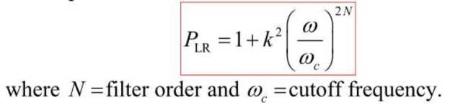
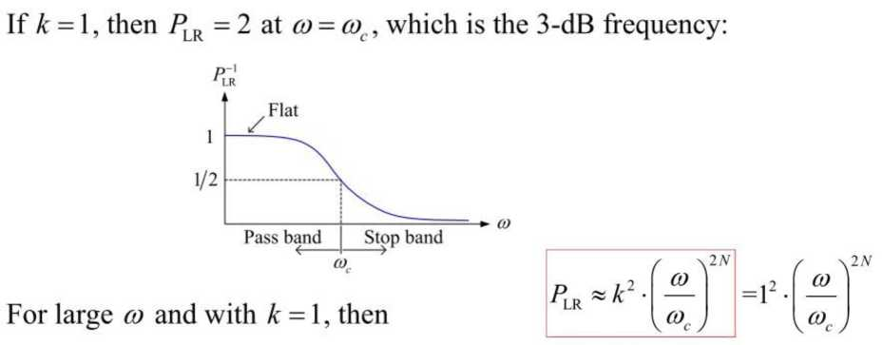
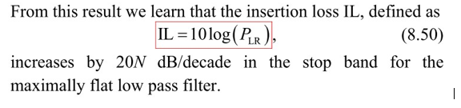
Types of Low Pass Filters
Maximally Flat, Butterworth, Binomial Filter:

Slide 4
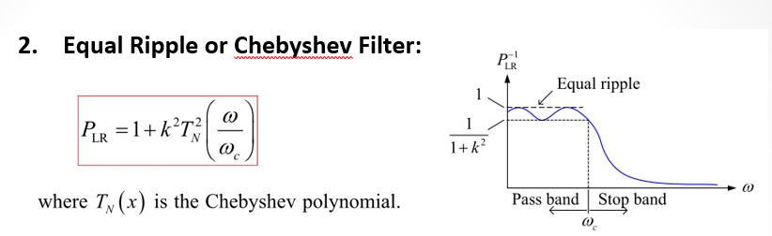

Slide 5
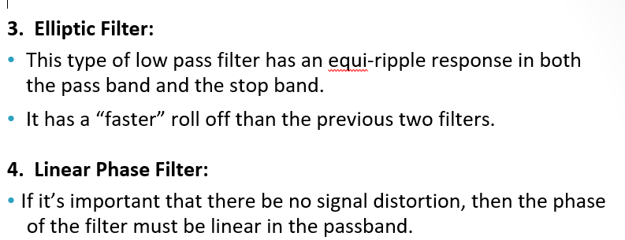

Slide 6
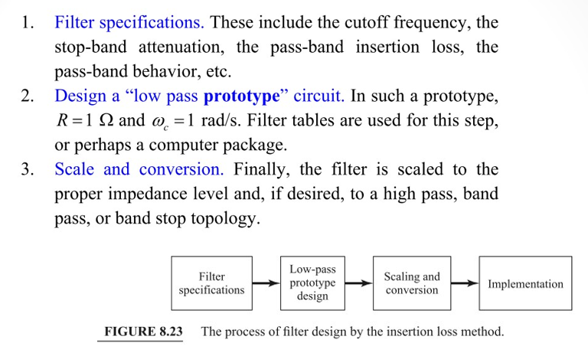
General Procedure for Filter Design
The general procedure for designing a filter using the insertion loss method can be summarized in three steps

Slide 7
STEPPED IMPEDANCE LOW PASS FILTERS
A relatively easy way to implement low-pass filters in microstrip or stripline is to use alternating sections of very high and very low characteristic impedance lines. Such filters are usually referred to as stepped-impedance, or hi-Z, low-Z filters, and are popular because they are easier to design and take up less space than a similar low-pass filter using stubs.

Slide 8
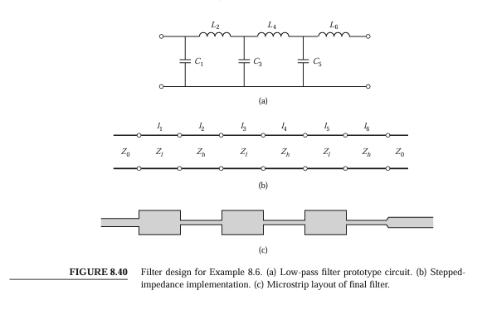

Slide 9
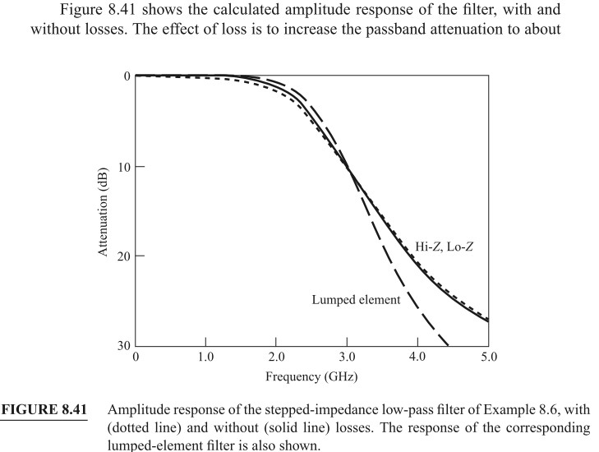
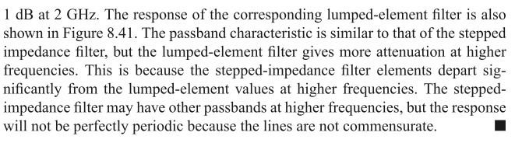

Slide 10
